Slide 1
Move Instructions
© 2015 John Sefcovic

Slide 2
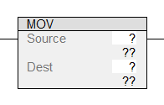
MOVE
The MOVE (MOV) is an output instruction when the rung conditions are true, will place a copy of the Source value, constant or reference Tag, into the Tag in the Destination.
Studio 5000

Slide 3
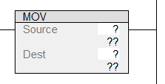
MOVE
RSLogix 5000
When the instruction is first entered, there are two sets of question marks for the Tag and tag value.

Slide 4
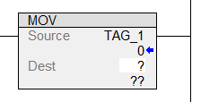
MOVE
RSLogix 5000
When the instruction is first entered, there are two sets of question marks for the Tag and tag value.
As the Tags are entered, the value stored at the tag is displayed.

Slide 5
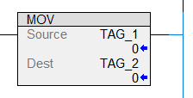
MOVE
RSLogix 5000
When the instruction is first entered, there are two sets of question marks for the Tag and tag value.
As the Tags are entered, the value stored at the tag is displayed.

Slide 6
MOVE
RSLogix 5000
When the instruction is first entered, there are two sets of question marks for the Tag and tag value.
As the Tags are entered, the value stored at the tag is displayed.
The values may be entered in the instruction or the Studio 5000 Tag Table-Monitor tab.

Slide 7
MOVE
OPERATIONS
SOURCE
32757
DESTINATION
BEFORE MOVE
0
DESTINATION
AFTER MOVE
32757

Slide 8
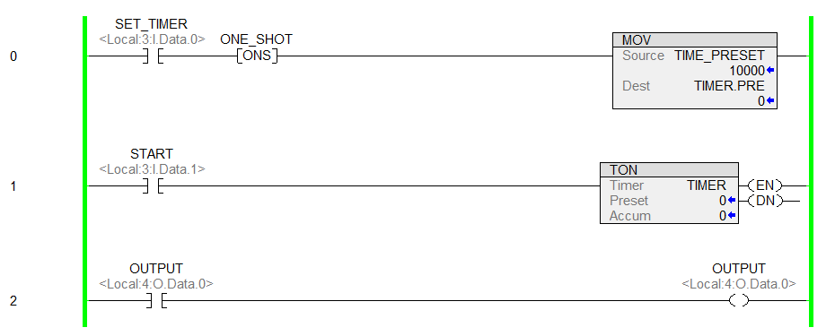
MOVE
The MOV instruction will copy the value of 10000 into the Timer’s Preset.

Slide 9
MOVE
The SOURCE is an Integer Tag with a value of 10000.
The DESTINATION is the Timer preset (.PRE).
10000
0
SOURCE
DESTINATION
TIME_PRESET
TIMER.PRE

Slide 10
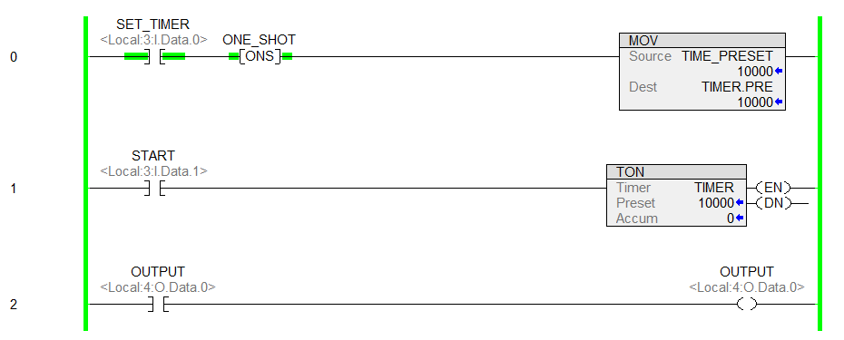
MOVE
When the rung is TRUE, the value of 10000 is moved into the timer’s preset setting the timer to 10 seconds.
10000
10000
SOURCE
DESTINATION
TIME_PRESET
TIMER.PRE

Slide 11

MOVE
The MOV instruction button is in the Move/Logical tab.

